Slide 1
8051 MICRCONTROLLER Memory organization and I/O PORTS
Farhan Sadaf
Lecturer, Dept. of CSE

Slide 2
Memory organization
The 8051 microcontroller has 128 bytes of Internal RAM and 4KB of on chip ROM .
The RAM is also known as Data memory and the ROM is known as program memory. The program memory is also known as Code memory .
This Code memory holds the actual 8051 program that is to be executed. In 8051 this memory is limited to 4K .
The 8051 has only 128 bytes of Internal RAM but it supports 64kB of external RAM.
As the name suggests, external RAM is any random access memory which is off-chip.

Slide 3
Internal RAM OF 8051
This Internal RAM is found on-chip on the 8051.
So it is the fastest RAM available, and it is also the most flexible in terms of reading, writing, and modifying it’s contents. Internal RAM is volatile, so when the 8051 is reset this memory is cleared.
The 128 bytes of internal RAM is organized as below:
Four register banks (Bank0, Bank1, Bank2 and Bank3) each of 8-bits (total 32 bytes). The default bank register is Bank0. The remaining Banks are selected with the help of RS0 and RS1 bits of PSW Register.

Slide 4
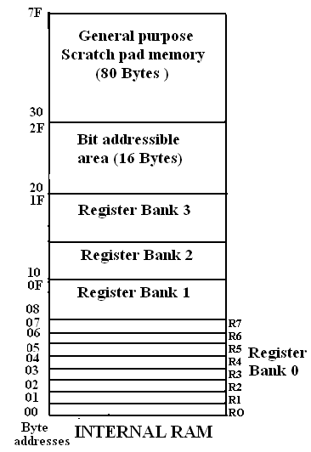
Internal RAM OF 8051

Slide 5
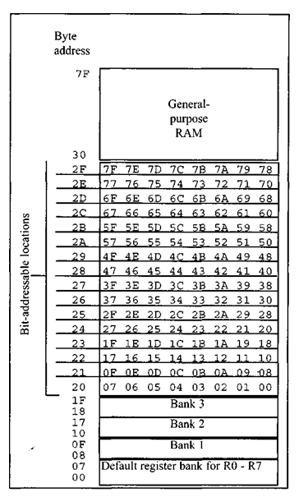
Internal RAM OF 8051

Slide 6
Internal RAM OF 8051
16 bytes of bit addressable area
80 bytes of general purpose area (Scratch pad memory) as shown in the diagram. This area is also utilized by the microcontroller as a storage area for the operating stack.
The 32 bytes of RAM from address 00 H to 1FH are used as working registers organized as four banks of eight registers each. The registers are named as R0-R7 .Each register can be addressed by its name or by its RAM address.
For ex. : MOV A, R7 or MOV R7, #05H

Slide 7
Internal ROM (On-chip ROM)
The 8051 microcontroller has 4KB of on chip ROM but it can be extended up to 64KB.
This ROM is also called program memory or code memory.
The CODE segment is accessed using the program counter (PC) for opcode fetches and by DPTR for data.
The external ROM is accessed when the EA (active low) pin is connected to ground or the contents of program counter exceeds 0FFFH.

Slide 8
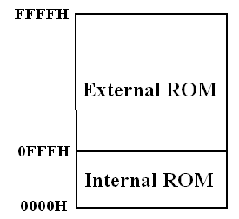
Internal ROM (On-chip ROM)
When the Internal ROM address is exceeded the 8051 automatically fetches the code bytes from the external program memory.

Slide 9
PARALLEL I /O PORTS
The 8051 microcontroller has four parallel I/O ports, each of 8-bits .
So, it provides the user 32 I/O lines for connecting the microcontroller to the peripherals.
The four ports are P0 (Port 0), P1 (Port1) ,P2 (Port 2) and P3 (Port3).
Upon reset all the ports are output ports.
In order to make them input, all the ports must be set i.e a high bit must be sent to all the port pins.

Slide 10
PORT 0
Port 0 is an 8-bit I/O port with dual purpose.
If external memory is used, these port pins are used for the lower address byte address/data (AD0-AD7), otherwise all bits of the port are either input or output.
Unlike other ports, Port 0 is not provided with pull-up resistors internally ,so for PORT0 pull-up resistors of nearly 10k are to be connected externally as shown in the fig on the next slide.

Slide 11
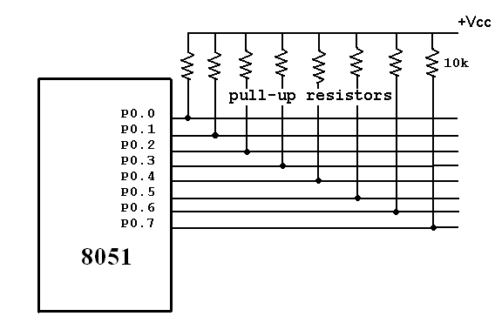
PORT 0

Slide 12
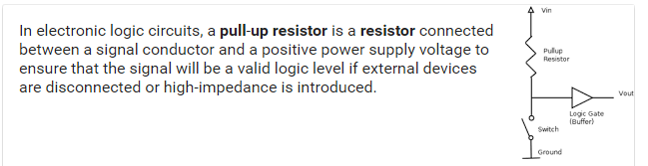
Pull-up Resistor

Slide 13
Dual role of port 0
Port 0 can also be used as address/data bus (AD0-AD7), allowing it to be used for both address and data.
When connecting the 8051 to an external memory, port 0 provides both address and data.
The 8051 multiplexes address and data through port 0 to save the pins. ALE indicates whether P0 has address or data.
When ALE = 0, it provides data D0-D7, and when ALE = 1 it provides address and data with the help of a 74LS373 latch.

Slide 14
Port 1
Port 1 occupies a total of 8 pins (pins 1 through 8).
It has no dual application and acts only as input or output port.
In contrast to port 0, this port does not need any pull-up resistors since pull-up resistors connected internally.
Upon reset, Port 1 is configured as an output port.

Slide 15
Port 1
To configure it as an input port , port bits must be set i.e a high bit must be sent to all the port pins.
For Ex :
MOV A, #0FFH ; A=FF HEX
MOV P1, A ; make P1 an input port by writing 1’s to all of its pins

Slide 16
Port 2
Port 2 is also an eight bit parallel port. (pins 21- 28).
It can be used as input or output port.
As this port is provided with internal pull-up resistors it does not need any external pull-up resistors.
Upon reset, Port 2 is configured as an output port.

Slide 17
Port 2
If the port is to be used as input port, all the port bits must be made high by sending FF to the port.
For ex,
MOV A, #0FFH ; A=FF hex
MOV P2, A ; make P2 an input port by writing all 1’s to it

Slide 18
Dual role of port 2
Port2 lines are also associated with the higher order address lines A8-A15.
In systems based on the 8751, 8951, and DS5000, Port2 is used as simple I/O port.. But, in 8051-based systems, port 2 is used along with P0 to provide the 16-bit address for the external memory.
Since an 8051 is capable of accessing 64K bytes of external memory, it needs a path for the 16 bits of the address.

Slide 19
Dual role of port 2
While P0 provides the lower 8 bits via A0-A7, it is the job of P2 to provide bits A8-A15 of the address.
In other words, when 8051 is connected to external memory, Port 2 is used for the upper 8 bits of the 16 bit address, and it cannot be used for I/O operations.

Slide 20
PORT 3
Port3 is also an 8-bit parallel port with dual function. (pins 10 to 17).
The port pins can be used for I/O operations as well as for control operations.
Port 3 also do not need any external pull-up resistors as they are provided internally similar to the case of Port 2 & Port 1.
Upon reset port 3 is configured as an output port

Slide 21
PORT 3
If the port is to be used as input port, all the port bits must be made high by sending FF to the port.
For ex,
MOV A, #0FFH ; A= FF hex
MOV P3, A ; make P3 an input port by writing all 1’s to it

Slide 22
Alternate Functions of Port 3
P3.0 and P3.1 are used for the RxD (Receive Data) and TxD (Transmit Data) serial communications signals.
Bits P3.2 and P3.3 are meant for external interrupts. Bits P3.4 and P3.5 are used for Timers 0 and 1 and P3.6 and P3.7 are used to provide the write and read signals of external memories connected in 8051 based systems

Slide 23
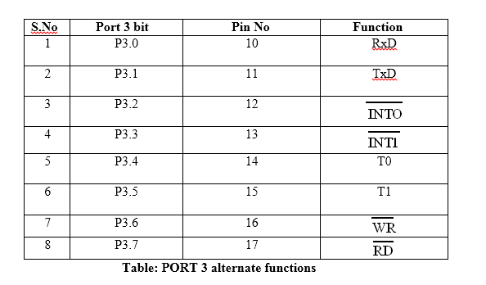
Alternate Functions of Port 3

Slide 24
Thank You

